Slide 1
Cohort state-transition Modeling in R
Using R for Decision Modeling in Health Technology Assessment
CE16
NIHES Erasmus Medical Center Rotterdam
February, 2020

Slide 2
Cohort State-Transition Models
Models where proportions of a cohort occupy states at each point in time (e.g., healthy, sick, stable, progressed, dead).
Transitions allowed between states with some probability.
Transitions occur in cycles (months, years etc).
Each state associated with a value associated with a model outcome ($, utility).
Markov assumption: no “memory” within states.

Slide 3
Building a cohort State-Transition Model
Determine health states
Determine transitions
Choose cycle length
Estimate transition probabilities
Estimate state utilities and costs per cycle
Calculate
Sensitivity analyses

Slide 4
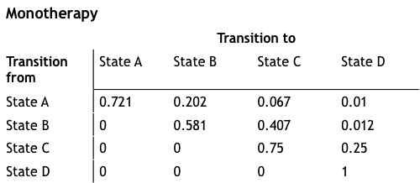
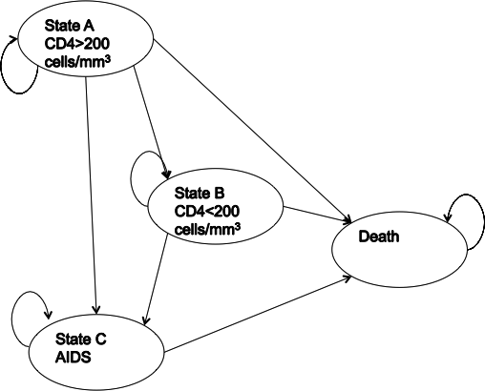
Markov Model of HIV Progression
Transition matrix
State-transition diagram
Drummond, Michael F. Methods for the economic evaluation of health care programmes. Oxford university press, 2005.

Slide 5
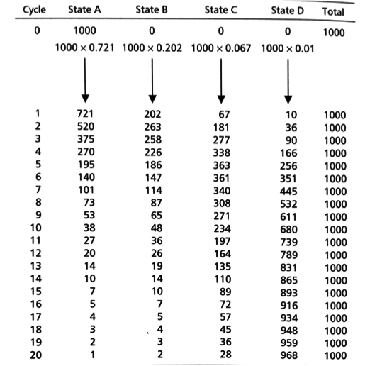
Markov
Trace
Number or distribution of individuals at each cycle

Slide 6
Three-State Model
p_HS
Healthy (H)
Sick (S)
p_HD
p_SD
Dead (D)

Slide 7
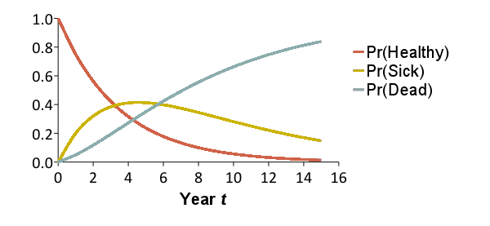
Trace the Cohort Through Time
Reflects the distribution of a cohort of patients over a set of health states over time
x₀ = [1.00 0.00 0.00]
x₁ = [0.75 0.20 0.05]
x₂ = [0.56 0.32 0.12]
x₃ = [0.42 0.38 0.19]
x₄ = [0.32 0.41 0.27]
x₅ = [0.24 0.41 0.35]
x₁₀ = [0.06 0.28 0.66]
0.20
0.15
0.75
Healthy
Sick
Dead
0.85
1.0
0.05
x_{t}(1)
x_{t}(2)
x_{t}(3)

Slide 8
Trace the Cohort Through Time
Reflects the distribution of a cohort of patients over a set of health states over time
x₀ = [1.00 0.00 0.00]
x₁ = [0.75 0.20 0.05]
x₂ = [0.56 0.32 0.12]
x₃ = [0.42 0.38 0.19]
x₄ = [0.32 0.41 0.27]
x₅ = [0.24 0.41 0.35]
x₁₀ = [0.06 0.28 0.66]
x₁₅ = [0.01 0.15 0.84]
0.20
0.15
0.75
Healthy
Sick
Dead
0.85
1.0
0.05
x_{t}(1)
x_{t}(2)
x_{t}(3)

Slide 9
Model as a Transition Matrix
Summarize transition probabilities as a matrix
Cohort distribution at next time step calculated through matrix multiplication
To:
 | Healthy | Sick | Dead
Healthy | 0.75 | 0.20 | 0.05
Sick | 0 | 0.85 | 0.15
Dead | 0 | 0 | 1.0
From:
= A
A
x_{t+1}
=
x_{t}

Slide 10
“Running” the Model
Summarize transition probabilities as a matrix
Cohort distribution at next time step calculated through matrix multiplication
To:
 | Healthy | Sick | Dead
Healthy | 0.75 | 0.20 | 0.05
Sick | 0 | 0.85 | 0.15
Dead | 0 | 0 | 1.0
From:
= A
A
0.75
0.20
0.05
x_{t+1}
=
x_{t}
0
0.85
0.15
0
0
1.0

Slide 11
“Running” the Model
Summarize transition probabilities as a matrix
Cohort distribution at next time step calculated through matrix multiplication
To:
 | Healthy | Sick | Dead
Healthy | 0.75 | 0.20 | 0.05
Sick | 0 | 0.85 | 0.15
Dead | 0 | 0 | 1.0
From:
= A
A
x₁
x₀
0.75
0.20
0.05
0.75
0.20
0.05
=
1.0
0.0
0.0
0
0.85
0.15
0
0
1.0

Slide 12
Markov Trace (Life-Years)
Calculate expected remaining LE, QALE, costs
Multiply cohort distribution by state-specific values to calculate expected value at each time
Sum expected values over time (discount if desired)
Life-Years:
1.0
1.0
0.0
Time | Healthy | Sick | Dead | E[LYs]
0 | 1.0 | 0.0 | 0.0 | --
1 | 0.75 | 0.20 | 0.05 | 0.95
2 | 0.56 | 0.32 | 0.12 | 0.88
3 | 0.42 | 0.38 | 0.19 | 0.81
 | … | … | …
Sum
* 1/(1+r)
* 1/(1+r)²
* 1/(1+r)³
Total life years: 6.77 years
(Remaining life expectancy)

Slide 13
Markov Trace (Costs)
Calculate expected remaining LE, QALE, costs
Multiply cohort distribution by state-specific values to calculate expected value at each time
Sum expected values over time (discount if desired)
Costs:
$500
$2,500
$0
Time | Healthy | Sick | Dead | E[Costs]
0 | 1.0 | 0.0 | 0.0 | --
1 | 0.75 | 0.20 | 0.05 | $875
2 | 0.56 | 0.32 | 0.12 | $1,081
3 | 0.42 | 0.38 | 0.19 | $1,1,72
 | … | … | …
Sum
* 1/(1+r)
* 1/(1+r)²
* 1/(1+r)³
Total costs: $11,557
(Total remaining lifetime costs)

Slide 14
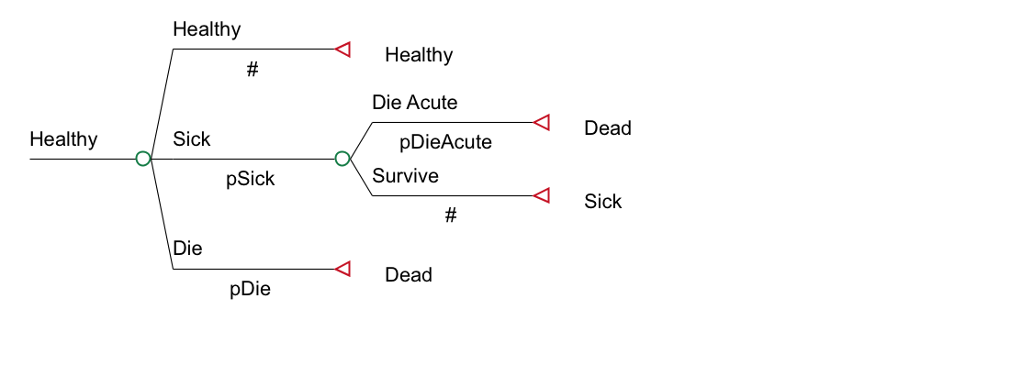
Transition Probabilities
Pr(Healthy → Dead) may not be conceptualized as one number
p_HD = p_Die + p_Sick * p_DieAcute

Slide 15
Parameter Estimation
Many parameters can be directly informed by primary or secondary data
Sometimes there is no direct information to inform a subset of parameters
However, data exist that are similar to output from the model
Estimation of these “deep” model parameters involves calibration

Slide 16
Microsimulation
Each patient proceeds through the decision tree one at a time
At each chance node, there is a p₁ chance they will go down the first branch, a p₂ chance they will go down the second branch, etc. Each patient will end up at one of the terminal nodes
Within a Markov cycle tree, patients will transition from state to state until they enter a state with a utility of 0
Allows “memory” to be introduced

Slide 17
Cancer Recurrence
(Recur=0)
Well
Recur
Dead
Recur=Recur+1
Well
Recur
Dead
(Recur=1)
Well
Recur
Dead

Slide 18
Populations vs. Cohorts
Depends on the perspective of the decision maker
What is the cost-effectiveness for the population of interest if intervention is implemented today?
Example: Cervical cancer screening
Option 1: Compare screening with no screening for cohort of 15-year-old girls
Run a cohort of 15-year-old girls under both strategies
Option 2: Compare screening with no screening for population of women ages 15-69
Run several cohorts: 15-19, 20-24, etc.
Costs and effectiveness are a weighted average of the multiple cohort runs
Dewilde & Anderson. Med Decis Making 2004;24:486.

Slide 19
Population Models
Models both the incident and prevalent cases over time (calendar time explicitly modeled)
Intervention duration
Length of time over which the intervention is applied per person or cohort
Implementation period
Period over which the intervention is applied
Analytic Horizon
Period over which costs and effects are assessed
Should be long enough to capture all meaningful differences in costs and effects between altenatives

Slide 20
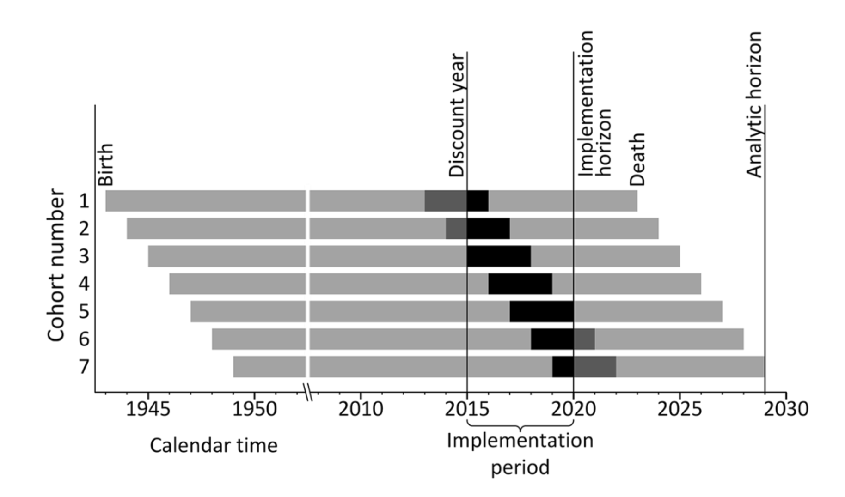
Population Evaluations
O’Mahony JF et al. PharmacoEconomics 2015;33:1255.

Slide 21
Conceptualizing the Markov model in R

Slide 22
Simple state transition model in R
p_HS
Healthy (H)
Sick (S)
p_HD
p_SD
Dead (D)
Notes:
Simple Markov to illustrate the use of Markov models
First letter from state and second letter to state

Slide 23
Simple state transition model
Model input:
p_{HS}: transition probability from Healthy to Sick
p_{HD}: transition probability Healthy to Dead
p_{SD}: transition probability Sick to Dead
c_{H}: cost of being in state Healthy
c_{S}: cost of being in state Sick
e_{H}: outcomes associated with state Healthy
e_{S}: outcomes associated with state Sick
No cost or disutility associated with death

Slide 24


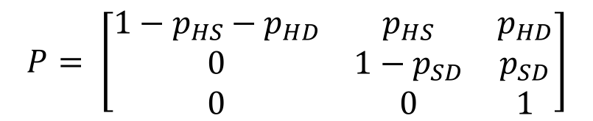
Matrix Implementation of the Markov Model
p_HS
Healthy (H)
Sick (S)
Transition probability matrix
Vector of cycle’s cost/outcomes
H S D
$$P= \left[\begin{matrix}1−p_{HS}−p_{HD} & p_{HS} & p_{HD} \\ 0 & 1−p_{SD} & p_{SD} \\ 0 & 0 & 1\end{matrix}\right]$$
H
S
D
p_HD
p_SD
Dead (D)
$$C= \left[\begin{matrix}c_{H} \\ c_{S} \\ 0\end{matrix}\right]$$
H
S
D
$$E= \left[\begin{matrix}e_{H} \\ e_{S} \\ 0\end{matrix}\right]$$
H
S
D
Notes:
Who is familiar with basic matrix calculations?
-> Inner product

Slide 25
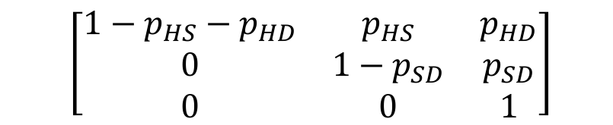

Matrix Implementation of the Markov Model
Create the t x 3 matrix M that will store the proportion of the cohort at each state and cycle:
At t = 0 :
M₀ = [1, 0, 0]
For t < T :
M_{t + 1}=M_{t} P
$$\left[\begin{matrix}1−p_{HS}−p_{HD} & p_{HS} & p_{HD} \\ 0 & 1−p_{SD} & p_{SD} \\ 0 & 0 & 1\end{matrix}\right]$$
$$\left[\begin{matrix}H_{t} & S_{t} & D_{t}\end{matrix}\right]$$

Slide 26
Calculating total costs & effects
E = M e
TE = 1_{T} E
Total effects (TE):
Total costs (TC):
C = M c
TC = 1_{T} C
1_{T} : 1 × T vector of ones
Notes:
M(tx3) e(3x1) = t * 1
(n x m) (m x p) = (n x p)

Slide 27
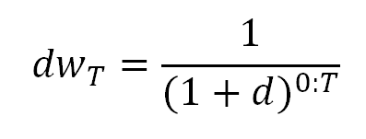
Calculating total costs & effects (discounted)
Total effects (TE):
Total costs (TC):
E = M e
TE = dw_{T} E
C = M c
TC = dw_{T} C
Notes:
M(tx3) e(3x1) = t * 1
(n x m) (m x p) = (n x p)

Slide 28
R Session
Notes:
Part 1 = Showing code 3 state model
Part 2 = Exercise build Sick-Sicker model
Part 3 = Show answers of Sick-Sicker

